Slide 1
Reverse and Narrative Poems
What they are, and how to create them.

Slide 2
Reverse Poem Definition:
A poem in which the lines make sense when read in order and when read in reverse order.
It’s really cool when it’s read backward and has the opposite meaning.
Every other line might be a clause or phrases that could stand alone.
The trick is making the lines work backward and forward with the lines above and below it.
(Warning– the next slide contains unpleasant pictures)

Slide 3
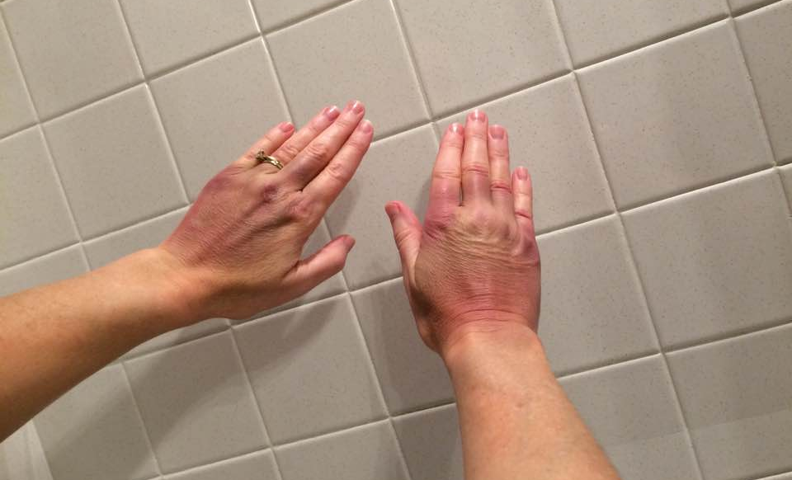
I wrote this one after I hurt my hands at the beach. (I typed it with my toes.)
How beautiful,
Like a sunset,
Red, purple, and blue.
They are symbols of carelessness.
Although my hands look battered,
I am lucky;
I shouldn’t whine about it.
I would not be writing this at all.
If I had gone in head first,
I might have broken my neck.
How clumsy!
(Now read it from the bottom up)
By: Ms. Davenport
(The next one is better)

Slide 4
Our Generation Our generation will be known for nothing. Never will anybody say, We were the peak of mankind. That is wrong, the truth is Our generation was a failure. Thinking that We actually succeeded Is a waste. And we know Living only for money and power Is the way to go. Being loving, respectful, and kind Is a dumb thing to do. Forgetting about that time, Will not be easy, but we will try. Changing our world for the better Is something we never did. Giving up Was how we handled our problems. Working hard Was a joke. We knew that People thought we couldn't come back That might be true, Unless we turn things around
Our generation will be known for nothing. (And now read this bottom to top)
“Our Generation” was written by a British student, Jordon Nichols, when he was 14-years-old. His brother posted it on social media, and it went viral!
(See this link for tips on writing your own reverse poem.)

Slide 5
Narrative Poem Definition:
A long poem that tells a story.
It’s really like a short story in verse.
A narrative poem contains short story elements, like exposition, conflict, climax, and falling action.
Not all poems that have stories are narrative! Be sure they have all the parts that a short story would have.
(“Annabel Lee” is a lyric poem. At 42 lines, it’s too short to be a narrative poem.)

Slide 6
Examples of Narrative Poems
Click the links…
“The Highwayman” by Alfred Noyes (The animation in this version is beautiful, but some of the poem is missing.)
“A Visit from St. Nicholas” (You know, “ ‘Twas the night before Christmas…”) by Clement Clark Moore
“The Midnight Ride of Paul Revere” by Henry Wadsworth Longfellow
“The Raven” by Edgar Allan Poe
If you choose to write a narrative poem. Make sure it has rhyme and meter and be sure it contains a complete story. (Can we analyze it with a plot diagram?)

